Slide 1
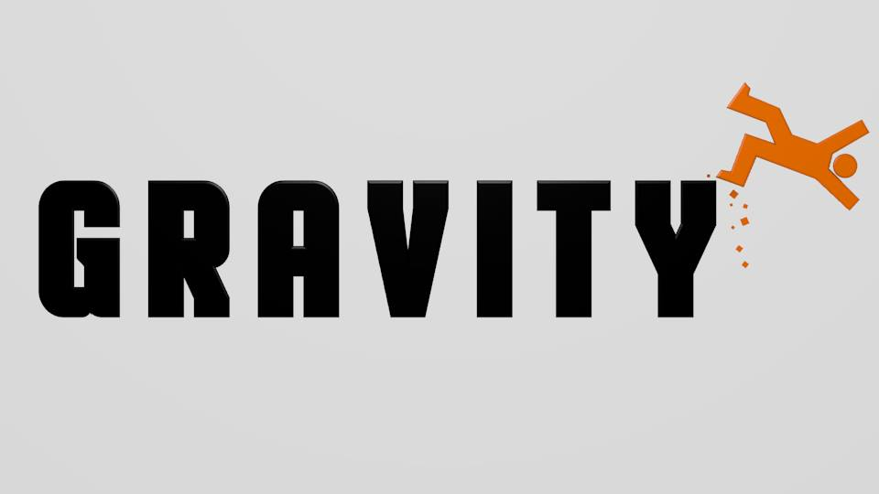
Team Gravity

Slide 2
Intellectual Properties
Found in a Software Application

Slide 3
Types
Foundation of software industry
Intellectual properties found in software:
Patents
Copyrights
Trade Secrets
Trademark

Slide 4
Trademark
Recognizable sign, design or expression
Patents, copyrights and trade secrets can be used to protect technology itself
Trademarks do not protect technology

Slide 5
Patents
Protection of “ideas”
20 year exclusive monopoly
Described in detail
Available to public

Slide 6
Obtaining Patents
Must apply to patent office
Must be demonstrated as new, useful and “nonobvious”
More than trivial, obvious next step in the advance of technology

Slide 7
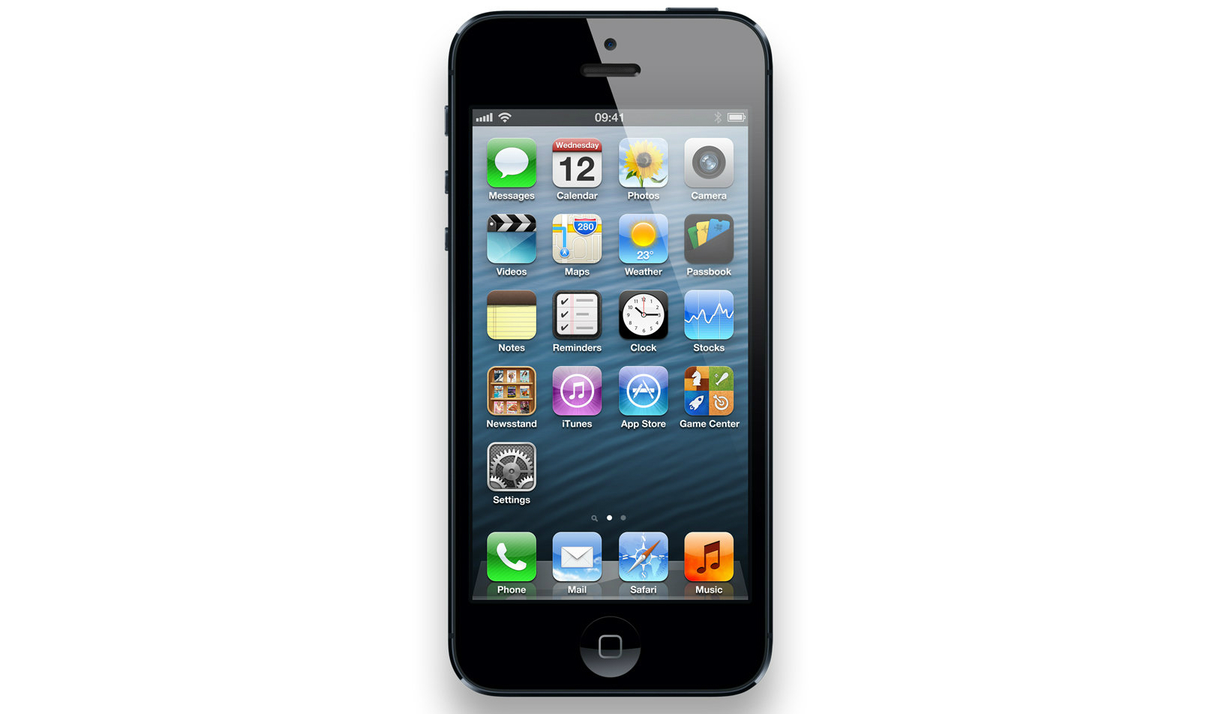

Patent examples
Algorithms, methods, systems
User-Interface Feature, Menu features
Apple patents

Slide 8
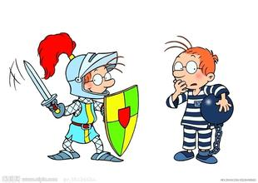
Copyright
What is copyright?
What is software copyright?
1. all the program code itself
2. documents that used to describe the contents,
design, testing results, etc. of a program.

Slide 9
Copyright
The difference between software copyright and patent:
COPYRIGHT | program itself | concrete
PATENT | development idea | abstract
Software copyright has nothing to do with protecting the most valuable thing in a software —— design ideas

Slide 10
Copyright
Features of copyright :
Made upon creation
Applying is unnecessary
Copyright protection is lifelong

Slide 11
Trade Secret
Any formula, pattern, process, tool or mechanism
Theoretically lasts forever
Subject to theft and not “infringement”

Slide 12
Conclusion
Intellectual properties are important!
Take caution with your projects!
Protect your hard work!

Slide 13
Questions?

Slide 14
Temp
Possible Split of Presentation:
Slides 1 – 4: Intro to presentation and short speech about trademarks =
Slides 5 – 6: Speech about patents =
Slides 7 – 8: Speech about copyrights =
Slides 9 – 11: Short speech about trade secrets and conclusion + questions =
Resource: http://www.freibrun.com/articles/articl2.htm and others
Patent - Patent protection offers broader rights than copyright protection because a patent creates a monopoly over the ideas it covers, whereas copyright only protects the expression itself.
Copyright - It is much easier and less expensive to obtain copyright protection than patent protection. Plus, the more restricted copyright protection lasts longer than the greater protection granted by patents.
It is advisable to display the copyright notice on each software and to file for patent protection to cover an innovative computer-related invention.

Slide 15
Temp
Trade Secret- A trade secret is a formula, practice, process, design, instrument, pattern, or compilation of information which is not generally known or reasonably ascertainable, by which a business can obtain an economic advantage over competitors or customers.
Trade Mark - A recognizable sign, design or expression which distinguishes products or service.

